Slide 1
Valkyrie Turns Management System
Created By Damien Zucker, Connor Soran and Dustin Crager

Slide 2



Team Introduction
Conor Soran
Damien Zucker
Dustin Dax Crager

Slide 3

What is the Purpose of our Project?
Our team was given the opportunity to create a professional site and provide a solution for scheduling subcontractors for a local business in Lakewood called Valkyrie Turns.
Our project aims to give Valkyrie Turns a reliable and efficient way to check their schedules online, capable of identifying units for each subcontractor to turnover for a given day and other useful functions.
3

Slide 4
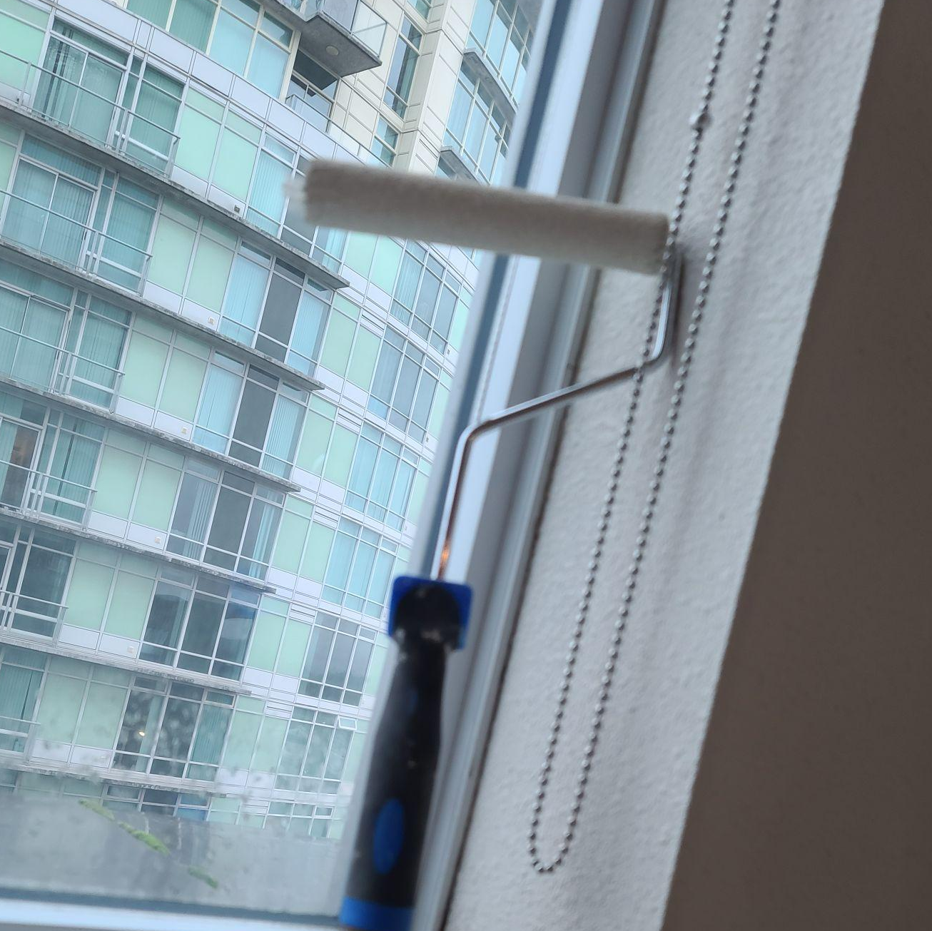
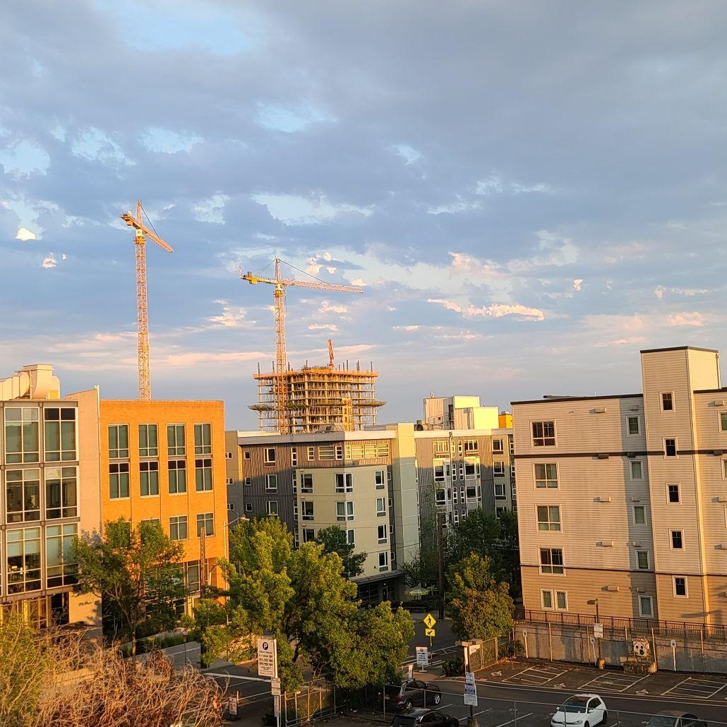
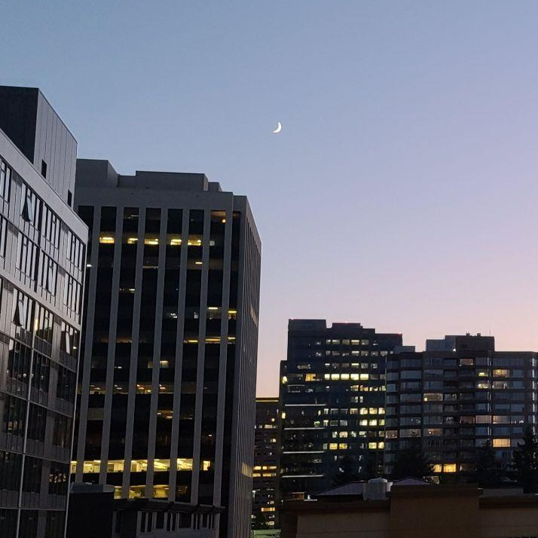
About Valkyrie Turns
Valkyrie Turns is a Apartment Turning business that operates in the greater Seattle area. They are formed of contractors who work on many different Apartment properties. These include Bellevue, Redmond, Seattle and Auburn area.

Slide 5
Features of the Application
Accurate Schedule and Apartment Turn Tracking
Available Units to Subcontractors
Information on Units
Professional and Informational website for customers and subcontractors.

Slide 6
Let’s review some concepts
Technologies
OUTLOOK
Secure way for schedulers to add apartment turn dates and info onto a interactable calendar.
HTML/CSS/JS
Fundamental Web-Based application languages used in construction of the application.
PHP/MySQL
The Database backbone for the project and saves user information.
AMAZON LIGHTSAIL
Easy secure server hosting solution with convenient and frequent backups and compatibility with MySQL.

Slide 7

Budget:
The Server will be hosted using Amazon Warehouse Services (AWS), which runs off of a recurring monthly payment. For this website, we utilized the free 3-month trial during the construction of the project. If the client is satisfied with the finished product, they may continue to host the service for $8 a month using AWS Lightsail.
7

Slide 8
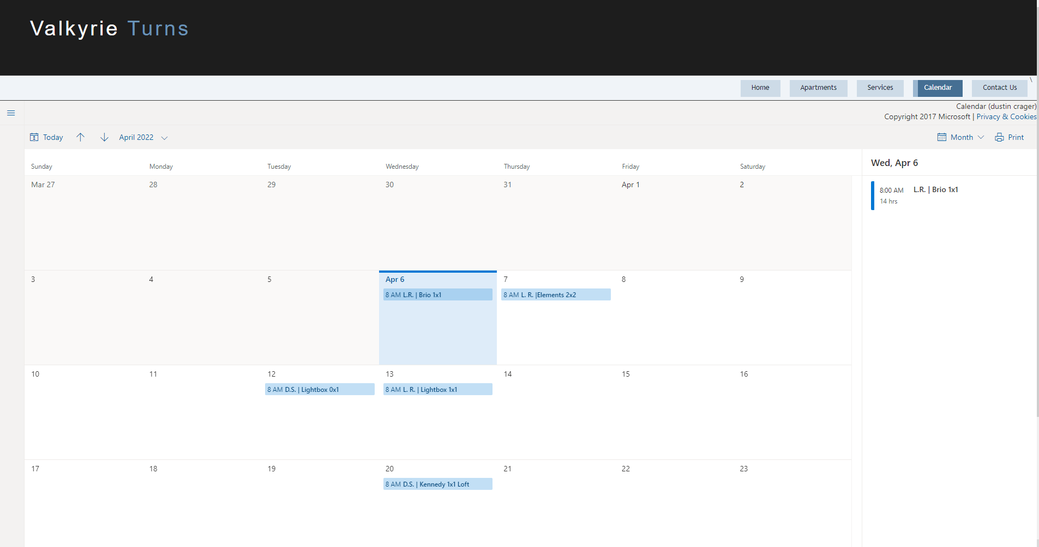
Schedule System

Slide 9
Project Schedule
Begin Construction of Base Website Technologies (HTML, CSS, JS, PHP)
Database Implementation and Connection to Main Site
Project is Completed and available for Client use.
JAN
FEB
MAR
APR
MAY
Database Login System Construction
Project Technologies are complete and Project Polishing and Fine Tuning begins

Slide 10

You can also split your content
Reviewing Previous Risks
IMPLEMENTATION
Valkyrie Turns currently runs its schedule using Outlook Calendars as a means to distribute apartment turns to contractors. Instead of scrapping and starting for scratch, we have learned how to implement this system into a convenient space.
EASE OF ACCESS
The system must be intuitive and easy to use, and avoid confusion by allowing the schedule to be easy to assign to contractors and easy to understand for the sub-contractors. The site will act as a handbook for subcontractors for information when they need it most.

Slide 11
Live Demo!

Slide 12
In two or three columns
Final Touches
LOGIN SYSTEM
Finalize the login page and hide the Calendar access to only employee accounts.
FINAL POLISH
Since this will be Valkyrie Turns first exposure as a new start-up, we want to create the best quality site for their start. To ensure this, we will make sure the site looks fresh and professional before delivery.

Slide 13
Thank you for watching!

